Slide 1
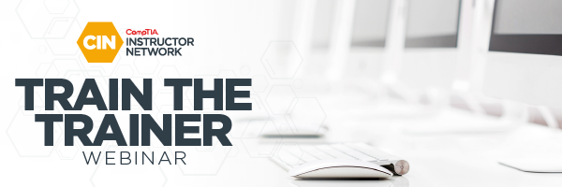
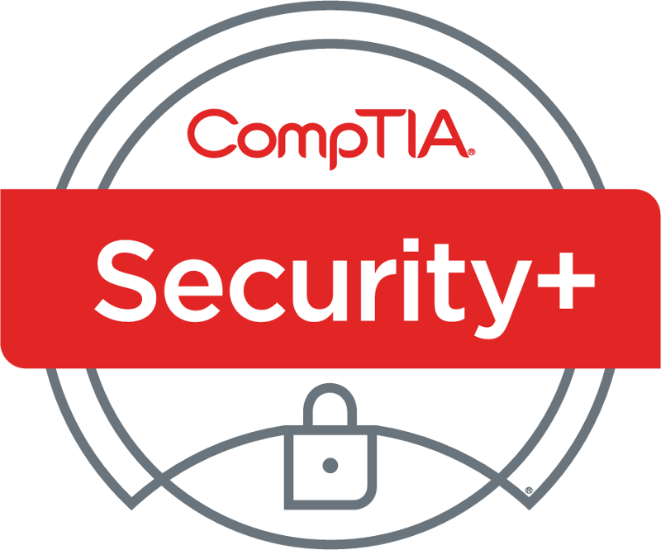
Security+ SY0-601 TTT Session 7
Domain 3 Implementation (Part 2)
February 16, 2021
@TeachCompTIA #SecurityPlusTTT

Slide 2
Certificate of Attendance
Contact CIN
Slides
Q&A
Bios
ON24 Help
Multimedia
Today’s Resources
Group Chat
Survey

Slide 3
Security+ SY0-601 TTT Session Outline
Date | Topic
2/16/2021 | 1.0 Attacks, Threats and Vulnerabilities
2/18/2021 | 1.0 Attacks, Threats and Vulnerabilities (continued)
2/23/2021 | 1.0 Attacks, Threats and Vulnerabilities (continued)
2/25/2021 | 2.0 Architecture and Design
3/02/2021 | 2.0 Architecture and Design (continued)
3/04/2021 | 3.0 Implementation
3/09/2021 | 3.0 Implementation (continued)
3/11/2021 | 4.0 Operations and Incident Response
3/16/2021 | 4.0 Operations and Incident Response (continued)
3/18/2021 | 5.0 Governance, Risk, and Compliance and Wrap-up
✓
✓
✓
✓
✓
✓
✓

Slide 4
Agenda
Domain 3.0: Implementation (Part two )
Domain 3.6: Given a scenario, apply cybersecurity solutions to the cloud.
Domain 3.7: Given a scenario, implement identity and account management controls.
Domain 3.8: Given a scenario, implement authentication and authorization solutions.
Domain 3.9: Given a scenario, implement public key infrastructure.
Review

Slide 5
Domain 3.3
Given a scenario, implement secure network designs.

Slide 6
POLL
When you search the internet for a web page the Root servers start the DNS process, if there was only one DNS root server, what impact would it have on the internet?
Nothing not every uses the ROOT
DOS attack symptoms
DDOS attack symptoms
A default Root could be found

Slide 7
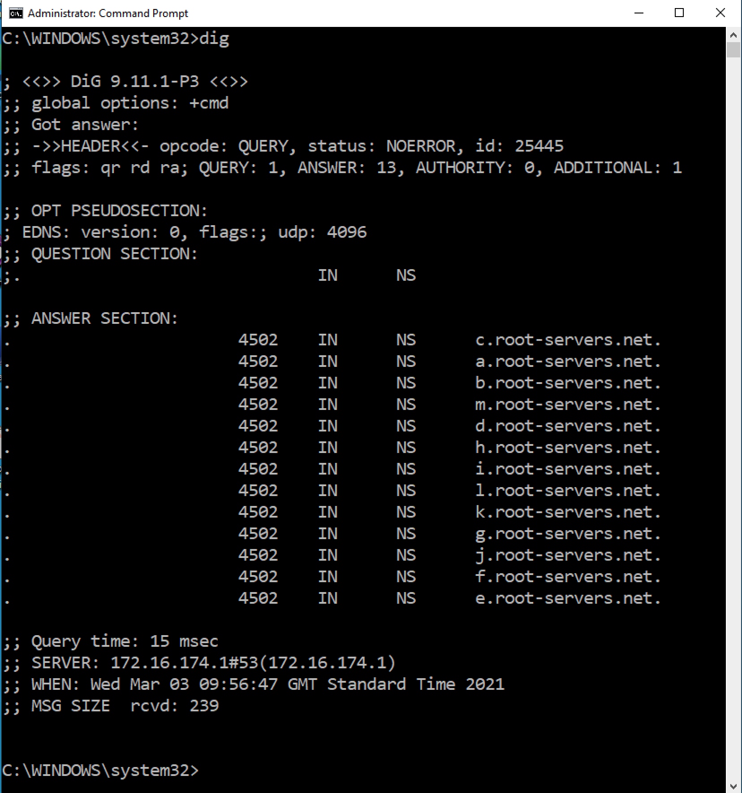
Dig on Windows

Slide 8
POLL
A DMZ is known as a?
VLAN
Subnet
Screened subnet
Round robin

Slide 9
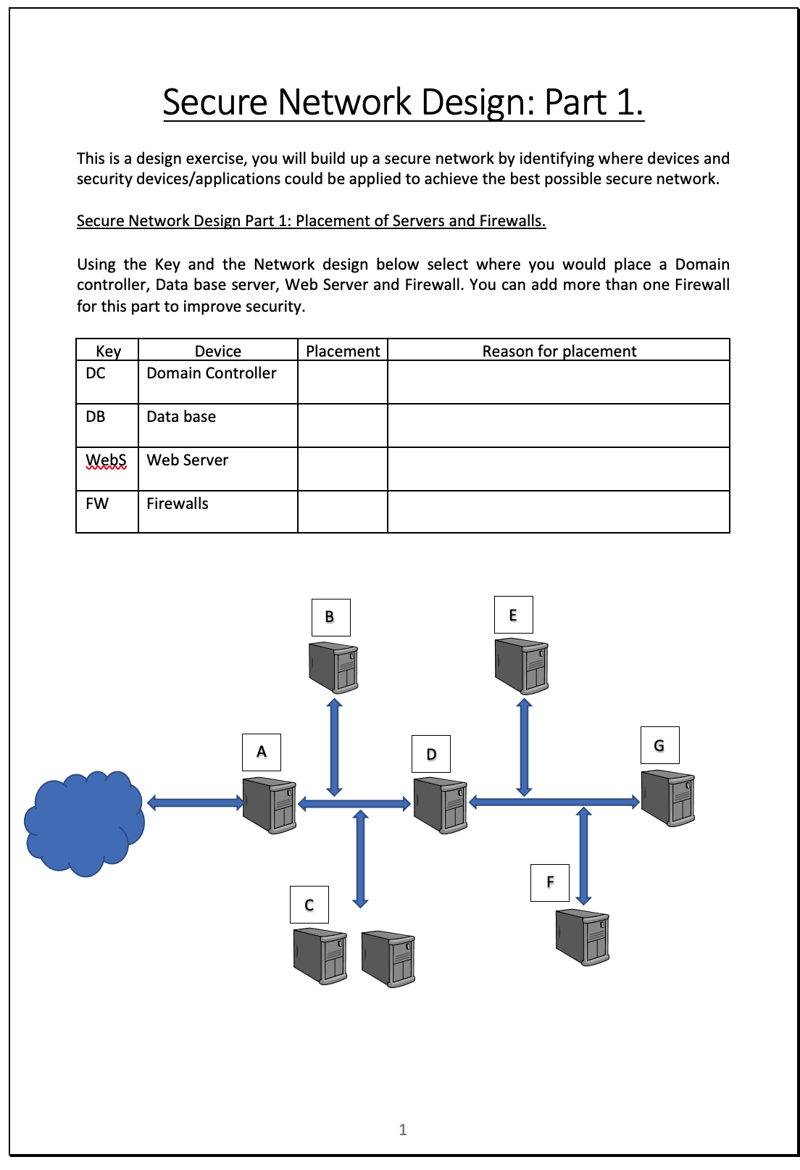
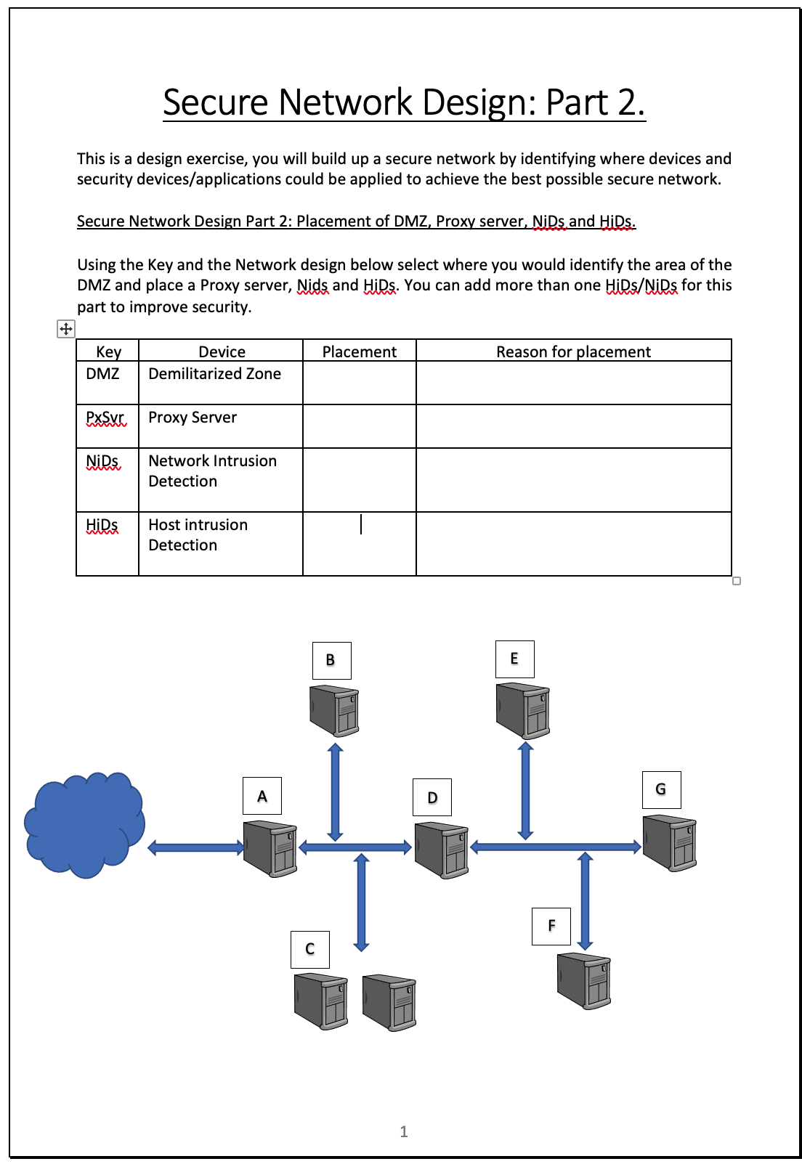
Network design

Slide 10
Domain 3.4
Given a scenario, install and configure wireless security settings.

Slide 11
POLL
In a public area, free internet access is available using open Wi-Fi. What else is used to ensure users are aware of rules of access and restrictions of use when connected to this free utility?
Captive session
Captive Portal
Captured packets
SSL sessions

Slide 12
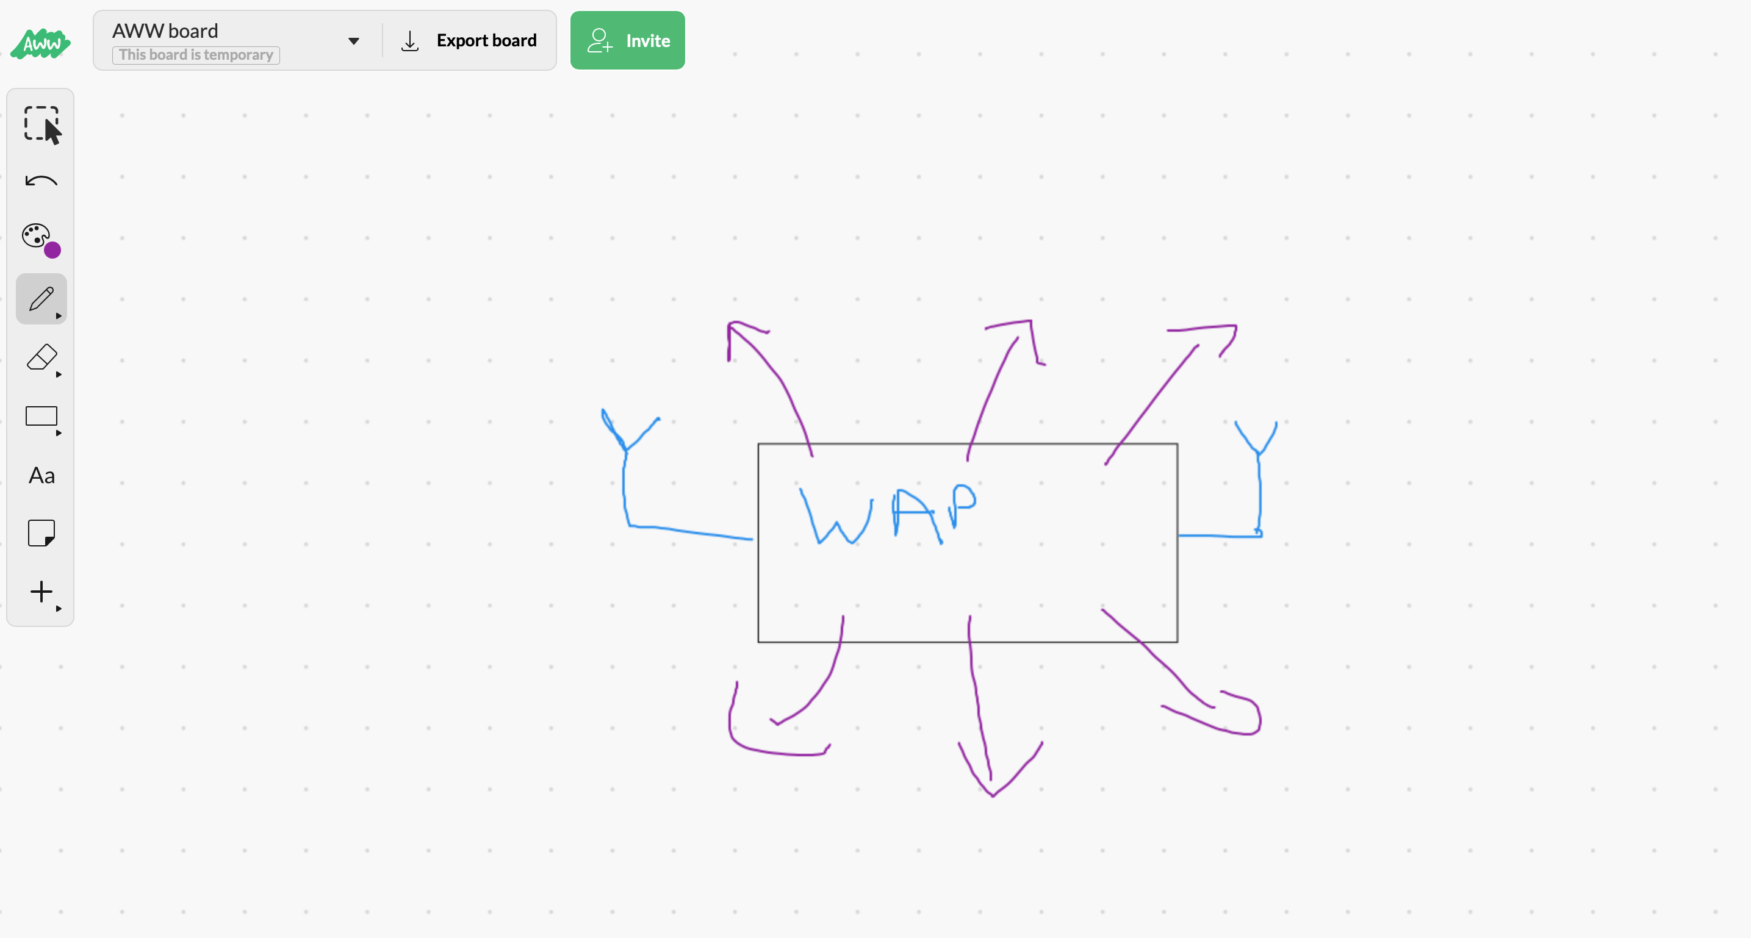
Setting up a WAP for a SOHO exercise
Team exercise:
Set up a WAP for a small business (SOHO)
This photo is for placement only

Slide 13
Domain 3.5
Given a scenario, implement secure mobile solutions

Slide 14
POLL
Which deployment model requires the employer to provide a list of approved devices for selection by employees?
BYOD
COPE
CYOD
COBO

Slide 15
Session resources
CompTIA Security+ SYO-601 objectives PDF

Slide 16
Security+
DOMAIN 3.0 Implementation

Slide 17
Session resources
CompTIA Security+ SYO-601 objectives PDF

Slide 18
Domain 3.6
Given a scenario, apply cybersecurity solutions to the cloud.

Slide 19
Cloud Security Controls
Identity and access management (IAM)
Endpoint protection (for virtual instances),
Policies to govern access to data and service
Firewalls to filter traffic between hosts
Logging to provide an audit function.

Slide 20
Poll
Generally, container security will be the responsibility of the XXX, unless operating a private cloud, while API use counts as security in the cloud.
CASB
CSP
CASP+
CAB
Notes:
(CSP) Cloud Service Provider

Slide 21
Application Programming Interface (API).
example, an application might allow a user account to be created via a URL:
https://TechTrainer11.co.uk/api/users?api_key=123456

Slide 22
JSON
The developer uses the POST method to submit data to the URL with the required parameters coded into the request body, often in JavaScript Object Notation (JSON).
POST /api/users HTTP/1.1
Content-Type: application/json
{
"user": {
"name": ”Peter",
"email": ”pthompson@Techtrainer11.co.uk"
}
}

Slide 23
Poll
The API used to create an account can be secured using two of the following?
Hashing
Secret keys
Certificates
Tokens
Notes:
(CSP) Cloud Service Provider

Slide 24
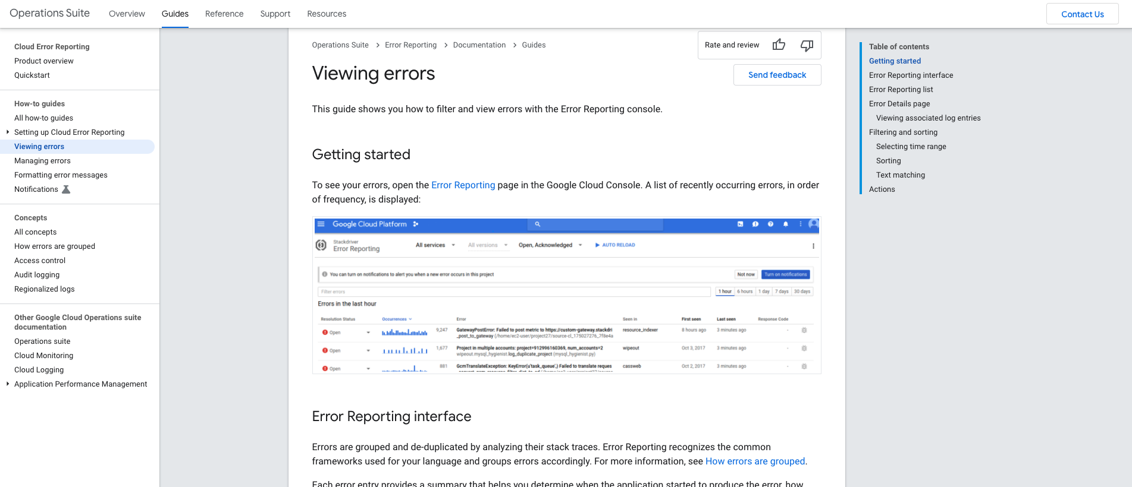
Error Reporting on cloud (Demo)

Slide 25
Domain 3.7
Given a scenario, implement identity and account management controls.

Slide 26
POLL
User accounts can be secure by the application of a single Security policy, However Policies can be applied from Local, Site, Domain and Organizational Units. How do we remember how these policies are applied?
Local, Domain, Site, Organizational Unit
Domain, Site, Organizational Unit, Local
Local, Site, Domain, Organizational Unit
Organizational Unit, Local, Domain, Site
Notes:
LSDOU

Slide 27
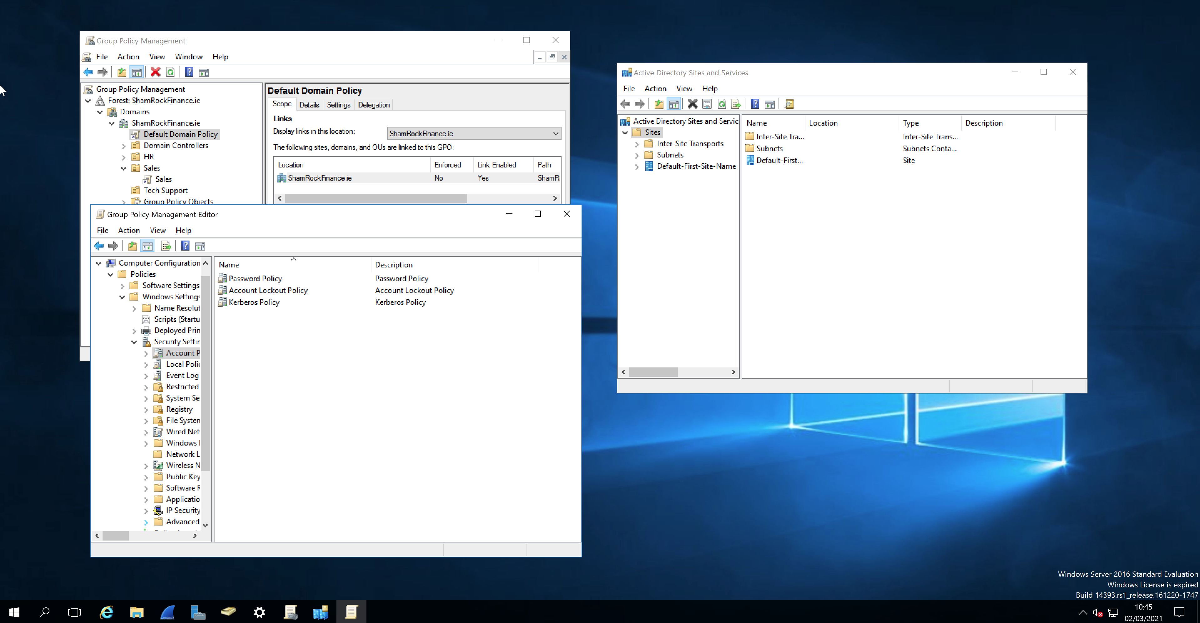
Group Policy Demo

Slide 28
POLL
On inspection of a RAS log its was found that an employee logged in remotely from Las Vegas 6 August 2018 at 21:00 CST within 10 mins the same account logged in from Nigeria. How could this be explained?
Impossible travel time
Risky login
Using a VPN
Faulty location service

Slide 29
Domain 3.8
Given a scenario, implement authentication and authorization solutions.

Slide 30
POLL
To use Bitlocker you will need an XXX to store the Cryptographic keys?
HSM
TPM
USB
KEY

Slide 31
POLL
Which of the following are examples of Access Control Schemes using MAC?
Bell-Lapadula
Clark and Wilson
Biba Integrity
Lattice model
All the above

Slide 32
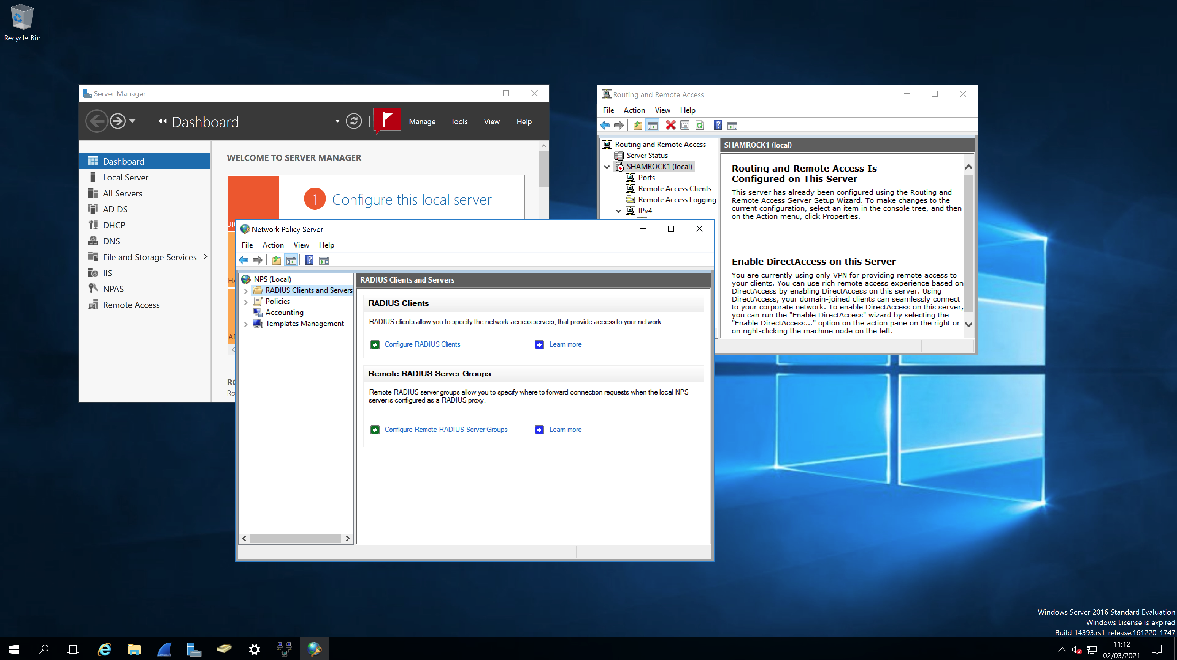
RADIUS on Windows 2019 server

Slide 33
Chat Question
Routing and Remote Access on a Windows server can be used with DHCP, What requires setting up to support DHCP?
This photo is for placement only

Slide 34
Domain 3.9
Given a scenario, implement public key infrastructure.

Slide 35
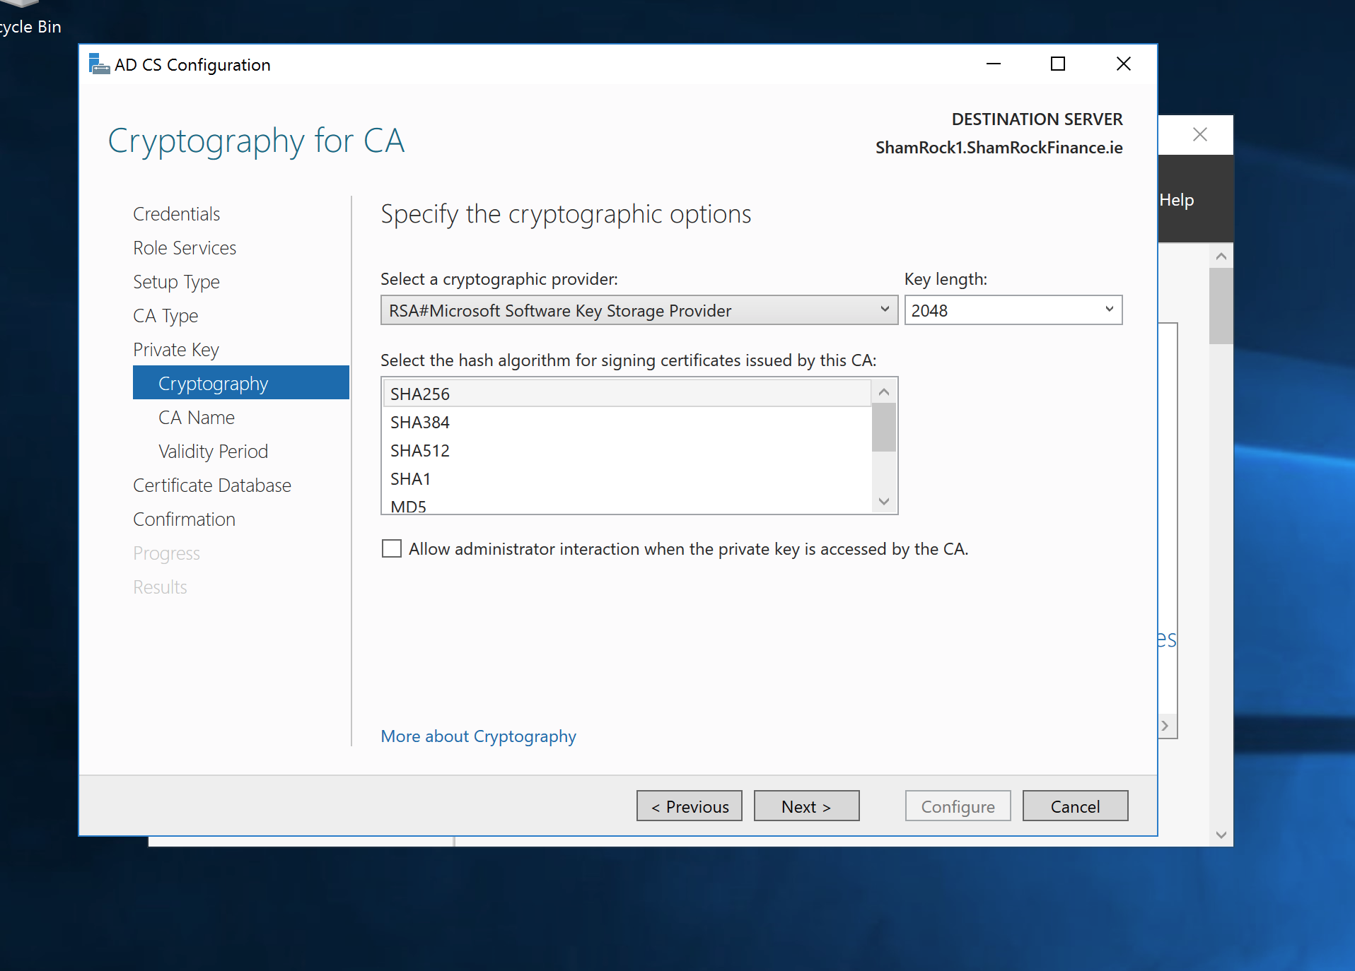
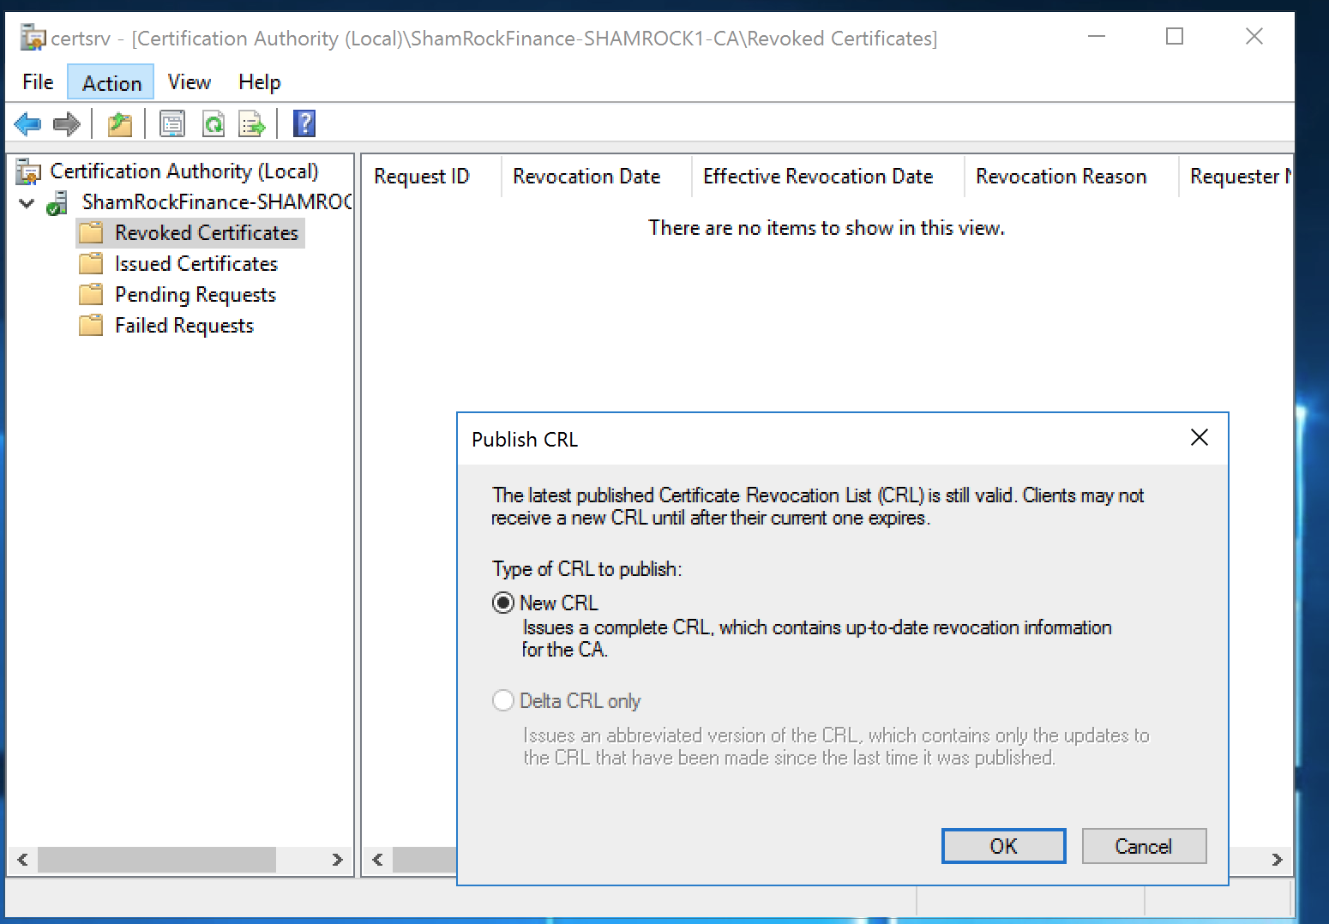
PKI Chat
What can be used to validate certificates if the CRL is too big?

Slide 36
PKI exercise

Slide 37
POLL
Which of the following is a alternative to Private key back up?
Key escrow
Key backup
Key Keeping
Key recovery

Slide 38
Session resources
CompTIA Security+ SYO-601 objectives PDF

Slide 39
Security+
DOMAIN 3.0 Implementation

