Slide 1
Linux+ XK0-005 TTT Session 2:
Domains 1.2 (Files) and 1.3 (Storage)
July 12, 2022
@TeachCompTIA #LinuxPlusTTT
<number>
Notes:
<number>

Slide 2
Certificate of Attendance
Multimedia
Slides
Bios
ON24 Help
Q&A
Today’s Resources
Group Chat
Survey
<number>

Slide 3
Qualifications for Exam Voucher Distribution
Participate in all 12 sessions (live or on-demand) during the date range for the live series (January 18th – March 17th).
Be an active member of CIN through engagement in the community.
Be involved with a CompTIA training partner or an independent instructor teaching CompTIA certifications.
For questions or clarifications talk with your CompTIA Business Development Manager.

Slide 4
Instructor:
Lee McWhorter Chief Technology Officer
Covered 6 LLC | DGP International
lee@covered6.com
Host:
Rick Bulter
Subbing in for Stephen tonight!

Slide 5
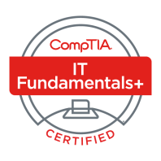
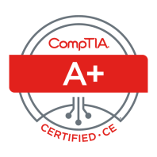
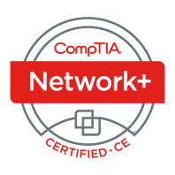
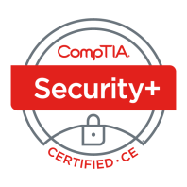
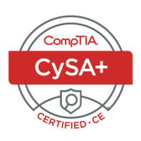
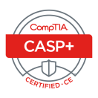
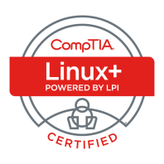
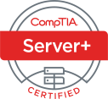
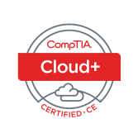
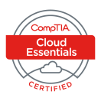
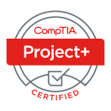
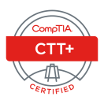
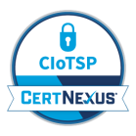
Lee McWhorter
CTO at Covered 6
CompTIA CIN Board member
lee@covered6.com
https://www.linkedin.com/in/lee-mcwhorter/
Twiiter: @tleemcjr
Previous TTT’s:
PenTest+ 001 2018
CASP+ 004 2021
PenTest+ 002 2022

Slide 6
Agenda
Session Objectives
Updated Resources
Domain 1.2
Domain 1.3

Slide 7
A+ Core 1 220-1101 TTT Session Outline
Date | Topic
7/11/2022 | Introduction, Linux+ Information, Resources, Domain 1.1
7/12/2022 | Domains 1.2 (Files) and 1.3 (Storage)
7/18/2022 | Domains 1.4 (Services) and 1.5 (Networking)
7/19/2022 | Domains 1.6 (Build) and 1.7 (Configuration)
7/25/2022 | Domains 2.1 (Best Practices) and 2.2 (Identity Management)
7/26/2022 | Domains 2.3 (Firewalls), 2.4 (Remote), and 2.5 (Access Controls)
8/01/2022 | Domains 3.1 (Scripts) and 3.2 (Containers)
8/22/2022 | Domains 3.3 (Git), 3.4 (IaC), and 3.5 (Orchestration)
8/23/2022 | Domains 4.1 (Storage), 4.2 (Network), and 4.3 (Processing)
8/30/2022 | Domains 4.4 (Permissions), 4.5 (Common Problems) & Wrap Up
✓
✓
<number>

Slide 8
The CompTIA Instructor Network (CIN) is a worldwide community for instructors who provide CompTIA certification training.
Communicate and collaborate with CompTIA staff and other instructors.
Access resources for students to understand the value of getting certified.
Receive complimentary training and tools from CompTIA to enrich your classroom.
Become proficient at teaching CompTIA standards.
Share best practices and resources with each other.
https://cin.comptia.org

Slide 9
The CompTIA Instructor Network (CIN) is a worldwide community for instructors who provide CompTIA certification training.
Linux+ Launch Webinar this coming Thursday 7/14/22
CompTIA Partner Summit August 3-4, 2022 in Chicago
CIN CTF as new part of CompTIA Partner Summit
https://cin.comptia.org

Slide 10
Section break
Updated Linux+ Resources
<number>

Slide 11
Linux+ Resources (Updated)
Kali Linux Revealed book and course
Chapter 3 of the book is a great primer for Linux basics
UPDATED URL: (other still works)
http://www.mctechs.com/CompTIA/Linux+TTT/Kali-Linux-Revealed-1st-edition.pdf
The newer course is supposedly still free…
https://kali.training/
<number>

Slide 12
Linux+ Resources
Previous Linux+ TTT
I can’t say enough about how great of a job Jason did on this one!
https://gateway.on24.com/wcc/eh/1119137/category/16389/linux-ttt-series/
https://cin.comptia.org/resources/categories/linux-xk0-004-ttt-series.8/
<number>

Slide 13
Linux+ Resources
Virtualbox
https://www.virtualbox.org/wiki/Downloads
VMWare (Note: Not free on MacOS, need to buy VM Fusion)
https://www.vmware.com/products/workstation-player/workstation-player-evaluation.html
<number>

Slide 14
Linux+ Resources
OSBoxes
https://www.osboxes.org/centos/
https://www.osboxes.org/fedora/
https://www.osboxes.org/kali-linux/
https://www.osboxes.org/ubuntu/
<number>

Slide 15
Linux+ Resources
https://ubuntu.com/download
https://getfedora.org/en/workstation/download/
https://www.redhat.com/en/technologies/linux-platforms/enterprise-linux
https://www.turnkeylinux.org/

Slide 16
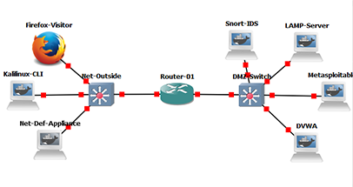
Linux+ Resources
https://gns3.com
<number>

Slide 17
Linux+ Resources (New)
http://www.mctechs.com/CompTIA/Linux+TTT/
Linux+_Class_Starter.gns3project
Linux+_Class_Starter.txt
Was originally used at Linux+ Class at 2019 CompTIA Partner Summit
<number>

Slide 18
Scripting Resources
https://www.techbrown.com/most-useful-bash-scripts-linux-system-administrator/
https://www.tomzone.fr/5-important-scripts-useful-for-a-linux-system-administrator/
https://github.com/errnair/sysadmin-shell-scripts
https://github.com/topics/linux-administration

Slide 19
Linux+ Resources (New)
https://overthewire.org/
Great Linux Primer game: Bandit
https://overthewire.org/wargames/bandit/
<number>

Slide 20
Section break
Domain 1.2
<number>

Slide 21
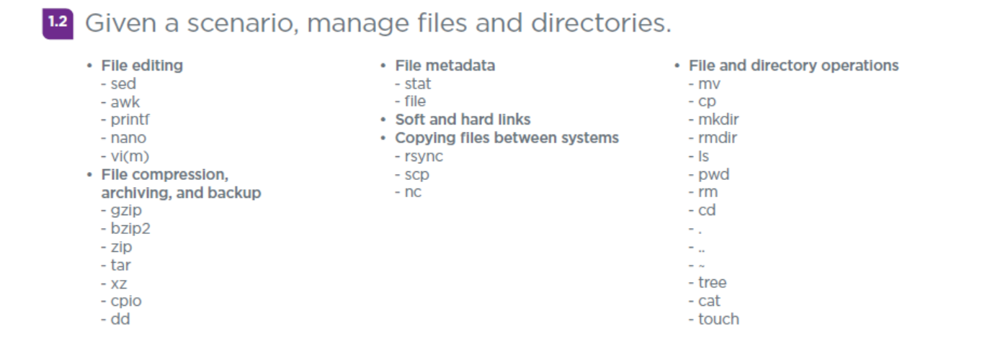
Domain 1.2 - Given a scenario, manage files and directories
<number>

Slide 22
Domain 1.2 - Given a scenario, manage files and directories
File editing
- sed – Short for stream editor, performs editing on text coming from standard input or a file.
https://www.gnu.org/software/sed/manual/sed.htmll
- awk – Awk goes with Gawk (GNU Awk) and is another stream editor.
- printf – Used to print pre-formated output.
- nano – Text editor which built on PICO, simple and easy to use.
- vi(m) – Old school text editor originally created for Unix, very powerful.
<number>

Slide 23
Domain 1.2 - Given a scenario, manage files and directories
File compression, archiving, and backup
- gzip – File format and utility for compression and decompression.
- bzip2 – File compression program, only compresses single files.
- zip – Command line utility to create .zip compressed files.
- tar – Command use to compress a group of files/folders into an archive.
- xz – General purpose compression similar to gzip and bzip2
- cpio – File format and general file archiver.
- dd – Command line utility coverting, copying and backing up files and devices.
<number>

Slide 24
Domain 1.2 - Given a scenario, manage files and directories
File metadata
- stat – Command which is used to give file and file system information. Such information includes file size, access permissions, user ID, group ID, and access times. Can also provide file system information.
- file - Command which display the type of a file.
Soft and hard links – to create a hard or soft (symbolic) links you use the ln command. Hard links allow multiple filenames to be associated with a single inode. Soft links are special files which point to another file by name.
<number>

Slide 25
Domain 1.2 - Given a scenario, manage files and directories
Copying files between systems
- rsync – Command line utility for synchronizing files and directories between different systems over a remote shell.
- scp – Secure copy is a command line tool for securely copying files and directories between two locations
- nc – Netcat can do so many things including copy files between systems.
Example:
$ tar -zcf - debian-10.0.0-amd64-xfce-CD-1.iso | pv | nc -l -p 3000 -q 5
$ nc 192.168.1.4 3000 | pv | tar -zxf -
<number>

Slide 26
Domain 1.2 - Given a scenario, manage files and directories
File and directory operations
- mv – The mv (move) command moves or renames files folders, etc.
- cp – The cp (copy) command copies files and folders.
- mkdir – This command is short for for Make Directory
- rmdir – This command is short for Remove Directory
- ls – One of the most commonly used utilities or all, ls stands for List is similar to the DIR command on DOS/Windows
- pwd – Displays the Present Working Directory
<number>

Slide 27
Domain 1.2 - Given a scenario, manage files and directories
File and directory operations
- rm – The rm command is short for Remove and is for files.
- cd – Just like on about ever OS, cd stands for Change Directory.
- . - In a directory listing, the single period (or dot) is the Current directory.
- .. - In a directory listing, double periods (or dots) is the Parent directory.
- ~ - This special character refers to and is shortcut for a user’s home directory.
- tree – Recursive directory listing command, originally comes from DOS.
- cat – Utility that reads file sequentially and write to standard output.
- touch – Utility that can update access or modification date of a file or can be used to create a new blank/empty file.
<number>

Slide 28
Chat Question
Who knows the proper name for the ~ character?
Answer in the chat window and let’s share.
This photo is for placement only

Slide 29
Section break
Domain 1.3
<number>

Slide 30
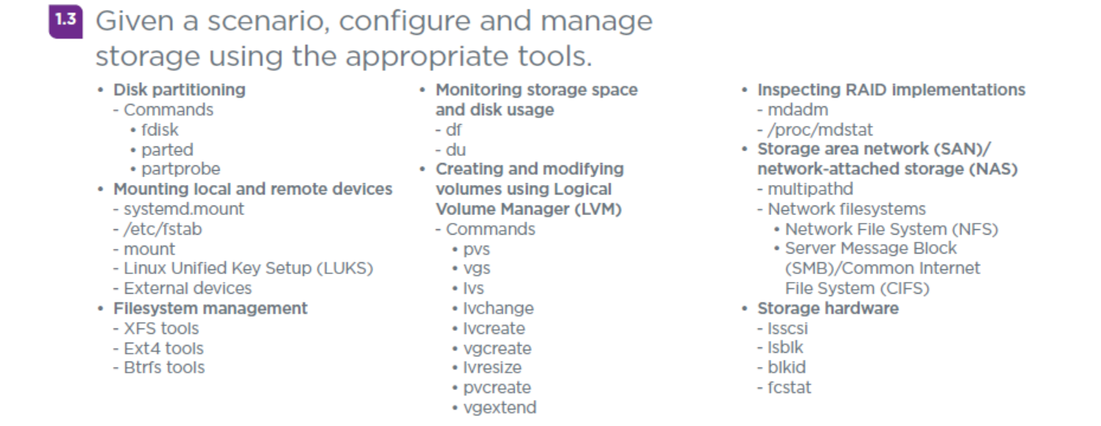
Domain 1.3 - Given a scenario, configure and manage
storage using the appropriate tools
<number>

Slide 31
Domain 1.3 - Given a scenario, configure and manage
storage using the appropriate tools
Disk partitioning
- Commands
• fdisk – Stands for “Fixed Disk” or “Format Disk” and is the most commonly used utility for disk manipulation.
• parted – Well known utility to manage disk partitions.
• partprobe – Program which informs an OS kernel of disk partition changes by causing the OS to reload the partition table.
<number>

Slide 32
Domain 1.3 - Given a scenario, configure and manage
storage using the appropriate tools
Mounting local and remote devices
- systemd.mount – Configuration file for mount points used by Systemd
- /etc/fstab – System configuration file used to list available disks and partitions and control their mounting. Used by Debian and many older Linux distros.
- mount – Utility used to ‘mount’ or setup for use, file systems. Can be used for any device, but commonly used for removable media.
- Linux Unified Key Setup (LUKS) – Disk encryption standard created in 2004 and used as a kernel level module.
- External devices
<number>

Slide 33
Domain 1.3 - Given a scenario, configure and manage
storage using the appropriate tools
Filesystem management
- XFS tools – xfs_growfs, xfs_repair, xfs_db, xfs_info, xfs_admin, xfs_metadump, and xfs_copy
- Ext4 tools – dumpe2fs, e2fsck, tune2fs, and debugfs
- Btrfs tools – btrfs, mkfs.btrfs, btrfs.check, and btrfs-convert.
<number>

Slide 34
Domain 1.3 - Given a scenario, configure and manage
storage using the appropriate tools
Monitoring storage space and disk usage
- df – Stands for Disk Free and displays available disk space information on file systems.
- du – Stands for Disk Usage and displays amount of disk space used by a particular folder or group of files.
Note: df is one of my key utilities to manage a system and check for indicators of compromise.
<number>

Slide 35
Domain 1.3 - Given a scenario, configure and manage
storage using the appropriate tools
Creating and modifying volumes using Logical Volume Manager (LVM)
- Commands
• pvs – Displays information about physical volumes.
• vgs – Displays information about volume groups.
• lvs – Displays information about logical volumes.
• lvchange – Used to change attributes of a logical volume.
• lvcreate – Creates a new logical volume in a volume group.
• vgcreate – Creates a new volume group.
• lvresize – Resizes a logical volume like lvextend and lvreduce.
• pvcreate – Initializes a physical volume for use by LVM.
• vgextend – Add one or more physical volume to a volume group.
<number>

Slide 36
Domain 1.3 - Given a scenario, configure and manage
storage using the appropriate tools
Inspecting RAID implementations
- mdadm – Utility for managing and monitoring a software RAID.
- /proc/mdstat – A special file which shows the state of the Linux Kernel’s md driver. Md (Multipe Devices) is a device driver that Linux uses to handle software RAID.
<number>

Slide 37
Domain 1.3 - Given a scenario, configure and manage
storage using the appropriate tools
Storage area network (SAN)/network-attached storage (NAS)
- multipathd – A Linux software daemon
- Network filesystems
Network File System (NFS)
Server Message Block (SMB)/Common Internet File System (CIFS)
<number>

Slide 38
Domain 1.3 - Given a scenario, configure and manage
storage using the appropriate tools
Storage hardware
- lsscsi – Lists information about SCSI devices.
- lsblk – Lists information about Block devices
- blkid – Lists available Block devices and their attributes.
- fcstat – Displays statistics gathered by the specified Fiber Channel device driver.
<number>

Slide 39
For Next Week
Set up some Linux VM’s
If interested, import the sample Linux GNS3 project into your GNS3.
Next class is Monday 7/18/22 and we will cover:
Domain 1.4
Domain 1.5
<number>

Slide 40
Discussion time: Please type your questions in chat
Questions over content.
Share you experience.
What would you like to see different moving forward?
Let’s keep the conversation going in the CompTIA Instructor Forum: https://cin.comptia.org
<number>

